Slide 1
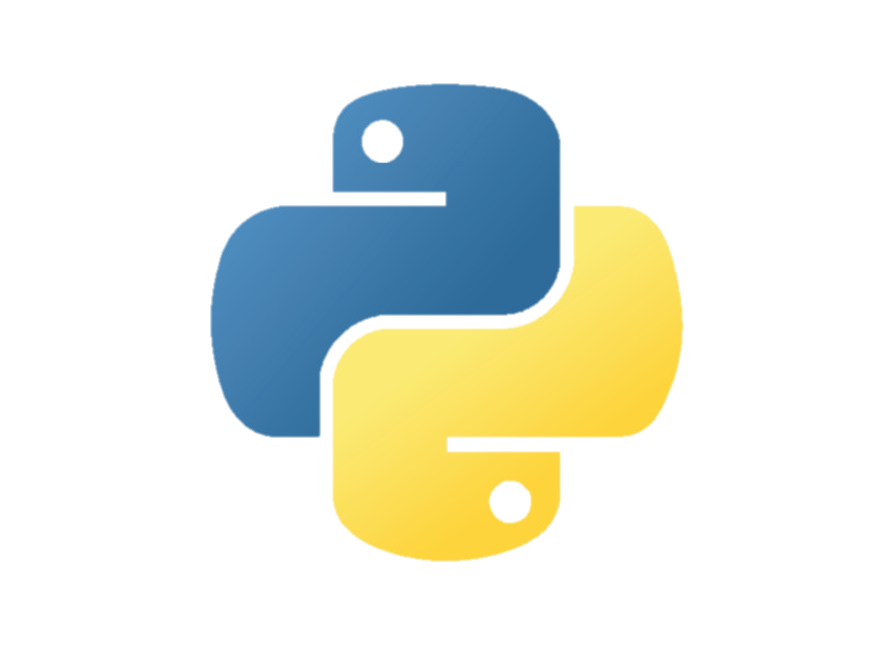
Introduction to python
By Philipp tiso
We will use repl.it as our IDE, hence you may want to create an account (use your google account).
Python Logo: https://www.kissclipart.com/python-programming-logo-clipart-python-programming-ufxms6/

Slide 2
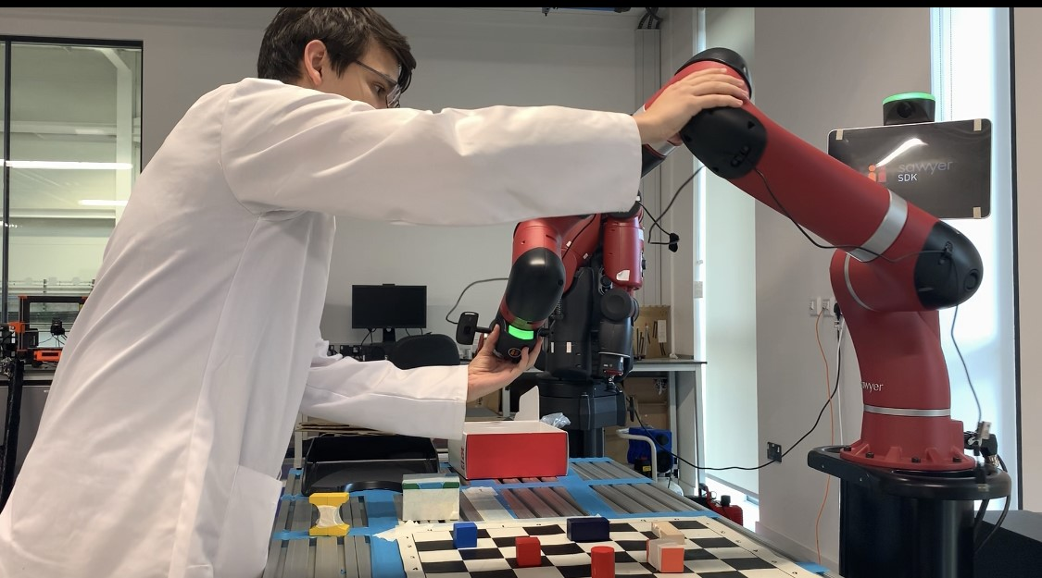
A bit about me
3rd Year student at the University of Nottingham
Interests:
Robotics
Computer Vision
Security
Currently working on human robot interaction for complex sorting
I work with Python a lot when it comes to robotics, mainly because of its abstraction

Slide 3
What is python?
High Level programming language
Compatible with multiple paradigms
Procedural
Object oriented
Functional
Interpreted language
Not compiled
Machine code is generated shortly before execution

Slide 4
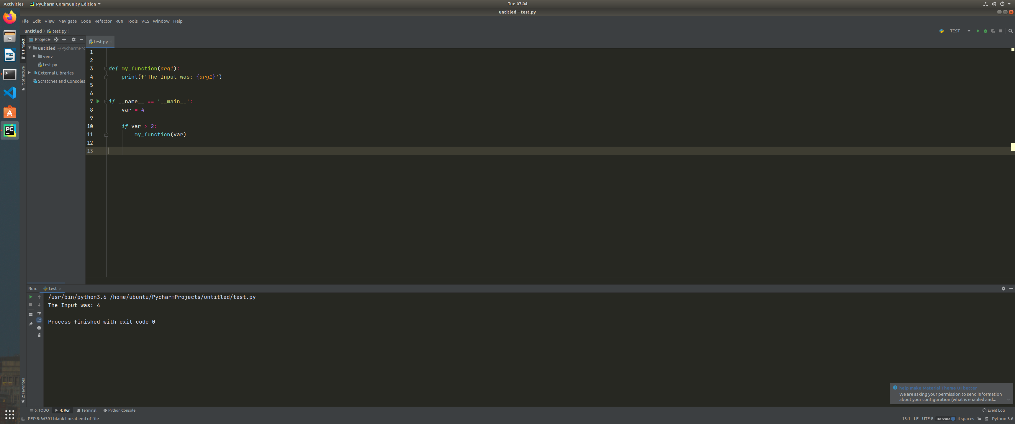
Basic syntax
Python uses indentation to denote scope changes
Python has predefined keywords which will perform predefined operations
if, else, elif
do, while, for, in
Etc.

Slide 5
Execution
We will look at procedural Python (already implies execution conventions)
Python programs will always start on the first line which is not a function if no __main__ was defined
When a function is called, python will jump to said function, execute the code and return

Slide 6

Function Definitions
Functions are blocks of code which can be called to execute from anywhere in a program
def function_name(arg1, arg2, …):
Arguments can have any name, as can our function
The only constrain is that names can’t be a number, nor can it start with a number
We can use the return keyword if we want to get a value back from the function
Using return will end the function, even if there is code below it

Slide 7
Python execution & function call
Call Stack
__main__
Start from the main

Slide 8
Python execution & function call
Call Stack
__main__
Assign the value 4 to the variable named var

Slide 9
Python execution & function call
Call Stack
__main__
Check if the value of var is greater than 2

Slide 10
Python execution & function call
Call Stack
__main__
Here we are calling a function defined above.
We pass var as the input to the function my_function

Slide 11
Python execution & function call
Call Stack
__main__
my_function
Remember where we called the function from
What do you think the value of arg1 is?
Hint: We passed it in in the previous step

Slide 12
Python execution & function call
Call Stack
__main__
my_function
Remember where we called the function from
Print the value that was passed to the function (4) to the screen
Now the function done with its code (notice the indentation), so we return back to where we called it from

Slide 13
Python execution & function call
Call Stack
__main__
Once all the operations in the main have executed, the program ends

Slide 14
What about data types?
Python is a typeless language
A variable can dynamically change its type, (int -> double -> string -> …)
We can have collections of individual values, we call these collections lists
my_list = [1, 3.14, -8, ‘This is a string’]
Notice that we can have a range of types within a list
Lets look at what this looks like in practice and have a go ourselves

Slide 15

List/Array types
Arrays can be accessed by using the [] operator
We index from 0, so the first element is at array[0]
We can get the last element with reverse indexing, array[-1]
Array accessing can be denoted as: array[start:stop:step]
Start: the index where we start
Stop: the index (exclusive) where we end, $\left\{x\right|start≤x<end\}$
Step: “Grab every $n^{th}$ element where $n$ is Step”
Grab the first 3 elements: array[:3]
Grab all elements from index 4 to 8: array[4:9]

Slide 16

Python branching/conditionals
Branching allows us to execute different pieces of code depending on some condition
Operators:
A equal to B: A == B
A strictly less than B: A < B
A strictly greater than B: A > B
A less than or equal to B: A =< B
A greater than or equal to B: A >= B
A or B , A and B
Not A: not A
Etc.
Lets try some of these

Slide 17
Python Loops
Most of the time programs will repeat a set of operations multiple times.
There are 2 main loop types
For loops
While loops

Slide 18
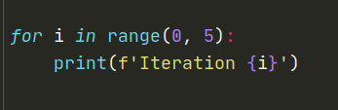
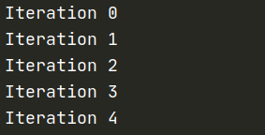
For Loop
We make use of the range() function that allows us to iterate over a sequence of integer values
There are many ways we can use the for loop, but lets stick to the basics for now
range(start, stop, step)
Note that we go from start to stop+1 via an increment of step
What would the output of the code above produce?
How would we iterate in a descending order?

Slide 19
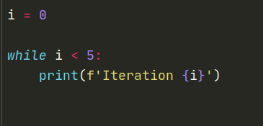
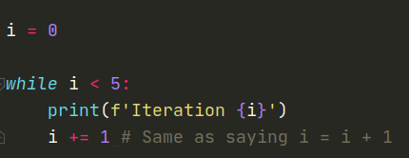
While loop
First check if the condition after the while keyword is true, if it is execute the body
Can you spot an issue with this?
This program will theoretically run forever, but why?
i is never incremented, so i will always be less than 5

Slide 20
Lets take 10 minutes for you to create your own script
Your script should include the following
A function that takes at least 2 arguments
One type of loop
Some output which can be displayed on the screen

Slide 21

Recursion
“In order to understand recursion, you must first understand recursion”
If we look at this closely, then we find that this tells us absolutely nothing. Or does it?
Recursion is when a function calls itself over and over again, until some termination condition is reached

Slide 22
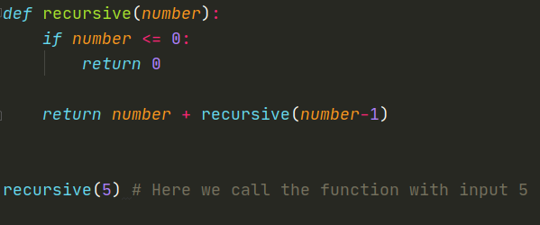
Recursion example
Call Stack
We call the recursive function from the main body, once we have finished executing the recursive function, we will end up back here

Slide 23
Recursive(5)
Call Stack
recursive(5)

Slide 24
Recursive(5)
Call Stack
recursive(5)

Slide 25
Recursive(5)
Call Stack
recursive(5)
recursive(4)
recursive(4) since 5-1 is 4

Slide 26
Recursive(4)
Call Stack
recursive(5)
recursive(4)

Slide 27
Recursive(4)
Call Stack
recursive(5)
recursive(4)

Slide 28
Recursive(4)
Call Stack
recursive(5)
recursive(4)
recursive(3)
recursive(3) since 4-1 is 3

Slide 29
Recursive(3)
Call Stack
recursive(5)
recursive(4)
recursive(3)

Slide 30
Recursive(3)
Call Stack
recursive(5)
recursive(4)
recursive(3)

Slide 31
Recursive(3)
Call Stack
recursive(5)
recursive(4)
recursive(3)
recursive(2)

Slide 32
Recursive(2)
Call Stack
recursive(5)
recursive(4)
recursive(3)
recursive(2)

Slide 33
Recursive(2)
Call Stack
recursive(5)
recursive(4)
recursive(3)
recursive(2)

Slide 34
Recursive(2)
Call Stack
recursive(5)
recursive(4)
recursive(3)
recursive(2)
recursive(1)

Slide 35
Recursive(1)
Call Stack
recursive(5)
recursive(4)
recursive(3)
recursive(2)
recursive(1)

Slide 36
Recursive(1)
Call Stack
recursive(5)
recursive(4)
recursive(3)
recursive(2)
recursive(1)

Slide 37
Recursive(1)
Call Stack
recursive(5)
recursive(4)
recursive(3)
recursive(2)
recursive(1)
recursive(0)

Slide 38
Recursive(0)
Call Stack
recursive(5)
recursive(4)
recursive(3)
recursive(2)
recursive(1)
recursive(0)

Slide 39
Recursion example
Call Stack
recursive(5)
recursive(4)
recursive(3)
recursive(2)
recursive(1)
recursive(0)
0 is less than or equal to 0, hence we execute the code in the if statement

Slide 40
Recursive(0)
Call Stack
recursive(5)
recursive(4)
recursive(3)
recursive(2)
recursive(1)
recursive(0)
0 is less than or equal to 0, hence we execute the code in the if statement

Slide 41
Recursive(1)
Call Stack
recursive(5)
recursive(4)
recursive(3)
recursive(2)
recursive(1)
recursive(0) gives us 0

Slide 42
Recursive(2)
Call Stack
recursive(5)
recursive(4)
recursive(3)
recursive(2)
recursive(1) gives us 0+1

Slide 43
Recursive(3)
Call Stack
recursive(5)
recursive(4)
recursive(3)
recursive(2) gives us 0+1+2

Slide 44
Recursive(4)
Call Stack
recursive(5)
recursive(4)
recursive(3) gives us 0+1+2+3

Slide 45
Recursive(5)
Call Stack
recursive(5)
recursive(4) gives us 0+1+2+3+4

Slide 46
Main Body
Call Stack
recursive(5) gives us 0+1+2+3+4+5 as our final result

Slide 47
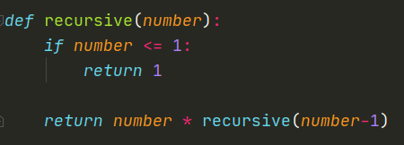
Exercise
You have exactly 5 seconds to modify this function to be an implementation of the factorial method (multiply all numbers from 1 to n)
Can you rewrite this function using iteration instead of recursion?

Slide 48
Recursion vs iteration
What problems could arise when we use recursion?
What if we put a massive number into our recursion function?
What if we don’t have a termination condition?
This is bad with iteration as well, but recursion is worse because of the memory allocation
Recursion does simplify certain problems, but in general iteration is used if we are expecting a lot of repetition

